Slide 1
Coronavirus Disease 2019
Presented by
Jessica Minetello, RN
JMcCahey@mountloretto.org

Slide 2
Training Outline
What is the Novel Coronavirus?
How does COVID-19 Spread?
What are the common symptoms of COVID-19
When to seek emergency medical attention
How can you protect yourself?
Social Distancing
Hand Hygiene
Donning and Doffing PPE
What if you have symptoms of Covid-19?
Cleaning and Disinfecting
Monitoring Staff
Stress and Coping
QUESTIONS

Slide 3
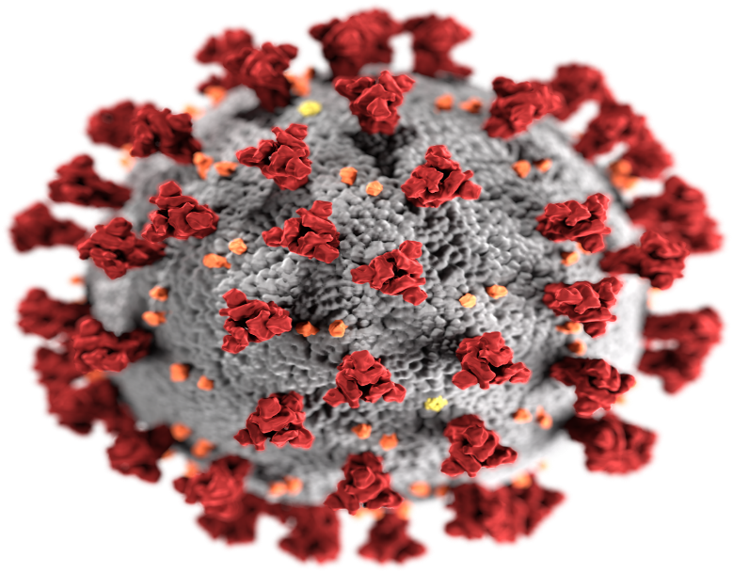
What is the Novel Coronavirus?
COVID-19 is a new disease that has not been seen previously in humans.
The virus is thought to be spread person-to-person by infected individuals mainly through respiratory droplets such as a cough or sneeze. These droplets can land in the eyes, nose, mouth of individuals who are nearby or can be inhaled into the lungs.
Tip: Be sure to practice social distancing and remain at least 6 feet apart from others (if possible) and wear a mask to protect others and yourself!
Notes:
Please note: It may be possible for Coronavirus to spread in ways other than person to person, but these are not thought to be the main ways the virus spreads.
From touching surfaces or objects. It may be possible that a person can get COVID-19 by touching a surface or object that has the virus on it and then touching their own mouth, nose, or possibly their eyes. This is not thought to be the main way the virus spreads, but we are still learning more about this virus.
From animals to people. At this time, the risk of COVID-19 spreading from animals to people is considered to be low.
From people to animals. It appears that the virus that causes COVID-19 can spread from people to animals in some situations. CDC is aware of a small number of pets worldwide, including cats and dogs, reported to be infected with the virus that causes COVID-19, mostly after close contact with people with COVID-19.

Slide 4
Symptoms of COVID-19
Anyone can have mild to severe symptoms
Older adults and individuals with severe underlying medical conditions have a higher risk of complications from COVID-19.
There are a wide array of symptoms that have been reported-ranging from mild to severe
Cough
Shortness of breath or difficulty breathing
Fever
Chills
Muscle Pain
Sore throat
New loss of taste or smell
Other less common symptoms have been reported, including gastrointestinal symptoms such as nausea, vomiting, diarrhea.
When to Seek Emergency Medical Attention
Look for emergency warning signs* for COVID-19. If someone is showing any of these signs, seek emergency medical care immediately
Trouble breathing
Persistent pain or pressure in the chest
New confusion
Inability to wake or stay awake
Bluish lips or face
*This list is not all possible symptoms. Please call your medical provider for any other symptoms that are severe or concerning to you.

Slide 5
Protecting Yourself
Maintain a social distance
Stay at least 6 feet apart (2 arms length) from other people
Do not gather in groups
Stay out of crowded places and avoid mass gatherings
Limit in person contact if possible.
Keep distance from others, especially those who are at high risk of getting sick

Slide 6
Protecting yourself-hANDWASHING
Notes:
FYI- There is no sound in this video

Slide 7
Protecting yourself- Wearing a mask
Cover your mouth and nose with a cloth face cover when around others
You could spread COVID-19 to others even if you do not feel sick.
Everyone should wear a cloth face cover or mask when they have to go out in public, for example to the grocery store or to pick up other necessities.
Cloth face coverings should not be placed on young children under age 2, anyone who has trouble breathing, or is unconscious, incapacitated or otherwise unable to remove the mask without assistance.
The cloth face cover is meant to protect other people in case you are infected.
Continue to keep about 6 feet between yourself and others. The cloth face cover is not a substitute for social distancing.

Slide 8
Protecting yourself- donning a mask
Before touching the mask, clean hands with an alcohol-based hand rub or soap and water
Take the mask and inspect it for tears or holes.
Orient which side is the top side (where the metal strip is).
Ensure the proper side of the mask faces outwards (the coloured side).
Place the mask to your face. Pinch the metal strip or stiff edge of the mask so it moulds to the shape of your nose.
Pull down the mask’s bottom so it covers your mouth and your chin.

Slide 9
Protecting yourself- doffing a mask
After use, take off the mask; remove the elastic loops from behind the ears while keeping the mask away from your face and clothes, to avoid touching potentially contaminated surfaces of the mask.
Discard the mask in a closed bin immediately after use.
Perform hand hygiene after touching or discarding the mask – Use alcohol-based hand rub or, if visibly soiled, wash your hands with soap and water.

Slide 10
Protecting yourself- removing gloves
Notes:
Some people are wearing double gloves. This is a preference and is not a recommendation from the CDC. You should wear gloves if caring for someone who is sick or cleaning and disinfecting. Always wash your hands with soap and water or an alcohol based hand sanitizer of at least 60% if soap and water is not readily available.

Slide 11
What if you have symptoms?
If you have a fever, cough or other symptoms, you might have COVID-19. Most people have mild illness and are able to recover at home. If you think you may have been exposed to COVID-19, contact your healthcare provider.
Keep track of your symptoms.
If you have an emergency warning sign (including trouble breathing), get emergency medical care immediately.
CDC website also has a self-checker to help guide you with appropriate care
https://www.cdc.gov/coronavirus/2019-ncov/if-you-are-sick/steps-when-sick.html

Slide 12
What if you have symptoms?
Stay home except to get medical care
Stay home. Most people with COVID-19 have mild illness and can recover at home without medical care. Do not leave your home, except to get medical care. Do not visit public areas.
Take care of yourself. Get rest and stay hydrated. Take over-the-counter medicines, such as acetaminophen, to help you feel better.
Stay in touch with your doctor. Call before you get medical care. Be sure to get care if you have trouble breathing, or have any other emergency warning signs, or if you think it is an emergency.
Avoid public transportation, ride-sharing, or taxis.

Slide 13
What if you have symptoms?
Separate yourself from other people
As much as possible, stay in a specific room and away from other people and pets in your home. If possible, you should use a separate bathroom. If you need to be around other people or animals in or outside of the home, wear a cloth face covering.
Monitor your symptoms
Follow care instructions from your healthcare provider and local health department. Your local health authorities may give instructions on checking your symptoms and reporting information.

Slide 14
What if you have symptoms?
Call ahead before visiting your doctor
Call ahead. Many medical visits for routine care are being postponed or done by phone or telemedicine.
If you have a medical appointment that cannot be postponed, call your doctor’s office, and tell them you have or may have COVID-19. This will help the office protect themselves and other patients.
If you are sick wear a face covering over your nose and mouth
You should wear a cloth face covering over your nose and mouth if you must be around other people or animals, including pets (even at home)
You don’t need to wear the cloth face covering if you are alone. If you can’t put on a cloth face covering (because of trouble breathing, for example), cover your coughs and sneezes in some other way. Try to stay at least 6 feet away from other people. This will help protect the people around you.
Cloth face coverings should not be placed on young children under age 2 years, anyone who has trouble breathing, or anyone who is not able to remove the covering without help.

Slide 15
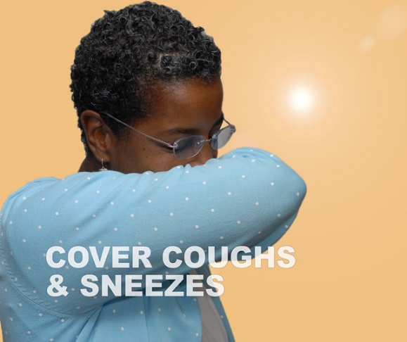
What if you have symptoms?
Cover your coughs and sneezes
Cover your mouth and nose with a tissue when you cough or sneeze.
Throw away used tissues in a lined trash can.
Immediately wash your hands with soap and water for at least 20 seconds. If soap and water are not available, clean your hands with an alcohol-based hand sanitizer that contains at least 60% alcohol.
Clean your hands often
Wash your hands often with soap and water for at least 20 seconds. This is especially important after blowing your nose, coughing, or sneezing; going to the bathroom; and before eating or preparing food.
Use hand sanitizer if soap and water are not available. Use an alcohol-based hand sanitizer with at least 60% alcohol, covering all surfaces of your hands and rubbing them together until they feel dry.
Soap and water are the best option, especially if hands are visibly dirty.
Avoid touching your eyes, nose, and mouth with unwashed hands.

Slide 16
What if you have symptoms?
Avoid sharing personal household items
Do not share dishes, drinking glasses, cups, eating utensils, towels, or bedding with other people in your home.
Wash these items thoroughly after using them with soap and water or put in the dishwasher.
Clean all “high-touch” surfaces everyday
Clean and disinfect high-touch surfaces in your “sick room” and bathroom; wear disposable gloves. Let someone else clean and disinfect surfaces in common areas, but you should clean your bedroom and bathroom, if possible.
If a caregiver or other person needs to clean and disinfect a sick person’s bedroom or bathroom, they should do so on an as-needed basis. The caregiver/other person should wear a mask and disposable gloves prior to cleaning. They should wait as long as possible after the person who is sick has used the bathroom before coming in to clean and use the bathroom.
High-touch surfaces include phones, remote controls, counters, tabletops, doorknobs, bathroom fixtures, toilets, keyboards, tablets, and bedside tables.
Clean and disinfect areas that may have blood, stool, or body fluids on them.
Use household cleaners and disinfectants. Clean the area or item with soap and water or another detergent if it is dirty. Then, use a household disinfectant.
Be sure to follow the instructions on the label to ensure safe and effective use of the product. Many products recommend keeping the surface wet for several minutes to ensure germs are killed. Many also recommend precautions such as wearing gloves and making sure you have good ventilation during use of the product.
Most EPA-registered household disinfectants should be effective.
Notes:
https://www.cdc.gov/coronavirus/2019-ncov/downloads/10Things.pdf 10 things you can do to manage your COVID symptoms at home.

Slide 17
Cleaning and disinfecting
What is the difference between cleaning and disinfecting?
Cleaning refers to the removal of germs, dirt, and impurities from surfaces. It does not kill germs, but by removing them, it lowers their numbers and the risk of spreading infection.
Disinfecting refers to using chemicals, for example, EPA-registered disinfectants, to kill germs on surfaces. This process does not necessarily clean dirty surfaces or remove germs, but by killing germs on a surface after cleaning, it can further lower the risk of spreading infection.
Clean and disinfect high-touch surfaces daily in household/office common areas (e.g. tables, hard-backed chairs, doorknobs, light switches, phones, tablets, touch screens, remote controls, keyboards, handles, desks, toilets, sinks)
FOLLOW ALL INSTRUCTIONS ON PRODUCT LABELS TO APPROPRIATELY DISINFECT SURFACES

Slide 18
Monitoring staff
At the beginning of every shift all staff will have their temperature taken and must report any symptoms. All temperatures and symptoms must be documented and submitted to Human Resources on a monthly basis.
Staff will be sent home with a temperature of 100.4 °F or above.
Staff is not permitted to return to work until they remain symptom free for at least three consecutive days

Slide 19
Stress and coping
It is natural to feel stress, anxiety, grief, and worry during and after a disaster. Everyone reacts differently, and your own feelings will change over time. Notice and accept how you feel. Taking care of your emotional/physical health during an emergency will help you think clearly and react to the urgent needs to protect yourself and your family. Self-care during an emergency will help your long-term healing.
Need help? Know someone who does?
If you, or someone you care about, are feeling overwhelmed with emotions like sadness, depression, or anxiety, or feel like you want to harm yourself or others:
Call 911.
Visit the Disaster Distress Helplineexternal icon, call 1-800-985-5990, or text TalkWithUs to 66746.
Visit the National Domestic Violence Hotlineexternal icon or call 1-800-799-7233 and TTY 1-800-787-3224.
https://store.samhsa.gov/sites/default/files/d7/priv/sma14-4885.pdf Coping With Stress During Infectious Disease Outbreaks

Slide 20
QUESTIONS
Notes:
Please feel free to reach out via email with any additional questions.

